Slide 1
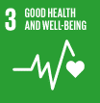
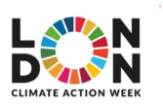
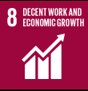
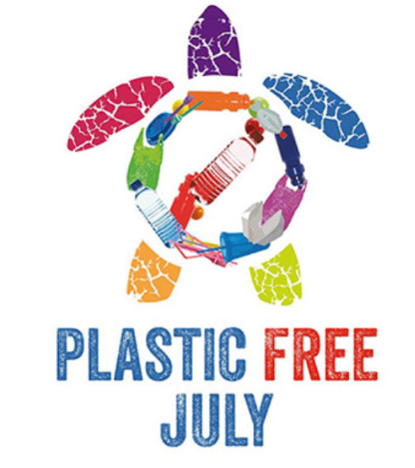
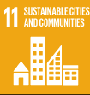
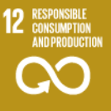
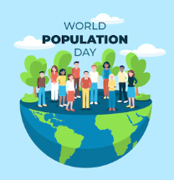
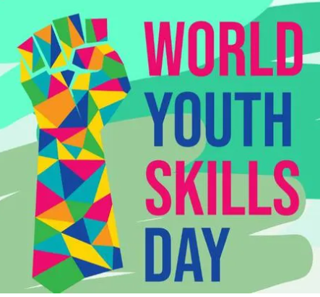
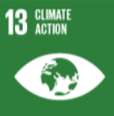
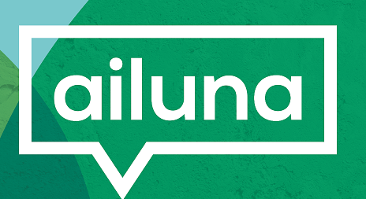
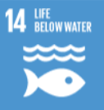
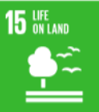
July
Eco Calendar 2023
It is in our hands
to make a better world
for all who live in it.
Mon | Tue | Wed | Thu | Fri | Sat | Sun
 |  |  |  |  | 1 London Climate Action Week | 2 London Climate Action Week
3 | 4 | 5 | 6 | 7 | 8 | 9
International Plastic Bag Free Day | Plastic Free July | The worst plastic polluters | 10 countries tackling plastic | A brief history of plastic | How to live without plastic | The story of plastic animation
10 | 11 | 12 | 13 | 14 | 15 | 16
World Population Day | Recycling Plastic | Documentary | Worms and plastic | World Youth Skills Day | Arctic Sea Ice Day | Less plastic Tips
17 | 18 | 19 | 20 | 21 | 22 | 23
What is the problem with plastic | Plastic Free Schools | What is the problem with plastic | Kids against plastic | Change habits this summer
24 | 25 | 26 | 27 | 28 | 29 | 30
 |  |  |  | Love Parks Week | Love Parks Week | Love Parks Week
Living as plastic-free as possible is challenging but it is important for all of us to do what we can. Plastic has become one of the most harmful materials to our environment. From polluting oceans and harming wildlife, to filling up landfills for decades without decomposing, this material is having devastating short term and long term effects on our planet. The main culprits are the companies producing these products. Plastic is cheap, economical, and easy to mould, so it’s no wonder its use is so rampant. Our society has become increasingly dependent on plastic products, so making the shift to living with less plastic (and, eventually, living plastic-free) can be a challenge.
The rate that the human population is increasing is unsustainable: our planet cannot grow any bigger, so our population cannot continue to grow. Should we focus on
encouraging people to have less children, or to consume and produce less? Do you think the people who have the most children are the people who consume the most?
The share of green talent in the workforce has increased by more than 38% since 2015. This is one of the findings of the LinkedIn Global Green Skills Report 2022.
Most green skills are being used in jobs you may not expect, for example, fleet managers, data scientists, health workers, construction managers and technical sales representatives. Do you think that all jobs will eventually need to become green to adapt to the new times?
Ssanchez2.306@lgflmail.org

